Slide 1
Characterizing the current state of a propulsion engine: A comparison of machine learning frameworks
Presented by: Srishti Sehgal
National Research Council Canada
Engineering Science (AERO) @ University of Toronto
Srishti Sehgal
National Research Council Canada
Catherine Cheung
National Research Council Canada
Julio Valdes
National Research Council Canada
With special thanks to:
Canadian Aeronautics and Space Institute – AERO19 Conference May 14-16th , 2019 Laval, QC

Slide 2
Motivation
Machine learning models are being used in several fields.
Practical data is noisy, many variables/features available.
Diagnostics has traditionally been defined as the ability to detect and isolate a failure condition.
For many complex systems, distribution of failed to healthy states is skewed as failed events are not common.
Proposing a framework for propulsion engine diagnostics to distinguish between normal healthy operating conditions and failed system states.
Notes:
Machine learning has quickly taken over a number of fields and is poised to dominate in additional ones. It’s not limited to image recognition, healthcare, speech analysis and Defence.
Supervised learning is powerful but still severally limited. Once a good feature representation is given this type of algorithm can work well.
But in such domains, practical data is noisy. Not to mention, given the increased ability to populate systems with sensors, there are several variables available for analysis. Certainly, labour-intensive hand-engineering approach doesn’t scale well and we’d like to have algorithms that can automatically learn better feature representations than hand-engineered ones.
The term structural health monitoring usually refers to the process of implementing a damage detection strategy for aerospace, civil or mechanical engineering infrastructure.
Diagnostics has traditionally been defined as the ability to detect and isolate a failure condition.
The ultimate goal of this project is to develop a prognostic tool. This would be to build on diagnostic assessment and generate capability to predict the progression of the fault condition before failure actually occurs.
This framework incorporates expert knowledge for structural and dynamic properties of the engine, and recognizes the low tolerance for false alarms and false negatives.
This paper/presentation presents a framework for equipment diagnostics, a fist but critical step towards autonomous diagnostics and prognostics, relying on a mixture of unsupervised and supervised methods.
The concept of unsupervised autonomous monitoring and diagnostics is based on unsupervised techniques. This implies having an ability to learn on-line without human intervention or supervision.
Some of the major challenges to the method of novelty detection include: ability to execute as a n autonomous agent, use of learning algorithms that don’t require human supervision, simplified setup with minimal number of parameters to be estimated in advance, flexible evolving structure that dynamically adapts to the equipment signature, minimization of false alarms and portability to a wide variety of systems.

Slide 3
Outline
Motivation
Literature Review
Background
ROC Metrics
Auto-encoders
Machine Learning Models
Multi-task Learning
Experimental Setup – Models
Results
Discussion
Summary and Future Steps

Slide 4
Literature Review
IJPRAI
Several classification methods and anomaly detection methods were implemented to distinguish between normal healthy operating conditions and deteriorated conditions on a turbocharger system
The leader clustering algorithm was used to reduce the amount of data to train and develop the models. In this work, we expanded our analysis of the dataset by seeking out ways to reduce the dimensions of the data instead of reducing the data itself.
Several previous works have used autoencoders for feature learning or for dimensionality reduction since the number of neurons in the hidden layer is smaller than the dimension of the input. In fact, many studies [26, 27] showed that an autoencoder with nonlinear characteristic is more efficient than linear dimensionality reduction techniques such as Principal Component Analysis (PCA) when the input data have a nonlinear or a sparse structure. Overall, this provides significant benefits for the inspection task: the computational time and the required memory for storage. And even better, removing the redundant information by maximizing the covariance.
Hinton G, Salakhutdinov R. Reducing the Dimensionality of Data with Neural Networks. Science. 2006; 313(5786):504–507. https://doi.org/10.1126/science.1127647 PMID: 16873662
Notes:
Samples of total objects were built using the leader clustering algorithm. In this method, representative objects (leaders) are chosen to ensure that for every object in the dataset there is at least one leader sufficiently close in distance given a threshold (given a similarity metric). The algorithm can produce a sample that is structurally compatible with the whole dataset, thus ensuring that odd or outlying elements will not be left unaccounted in the sample, as may occur with random sampling. Here the dissimilarity measure used was Euclidean distance.

Slide 5
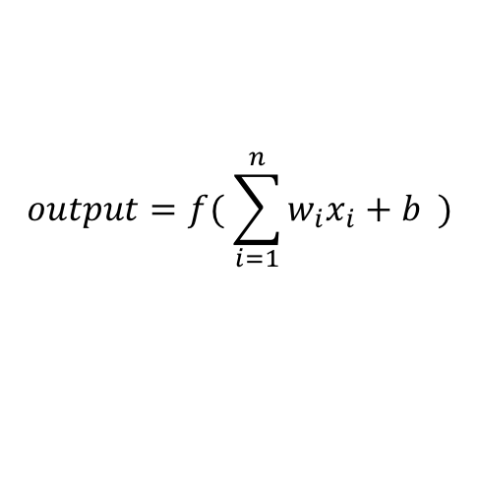
Background- Neural Network
features
x₁
w₁
w₁
w₂
w₃
x_{0, 1} | x_{1, 1} | x_{2, 1}
x_{0, 2} | x_{1, 2} | x_{2, 2}
b₁
b₂
$$output=f( \sum_{i=1}^{n}{w_{i}x_{i}}+b )$$
samples
+
…
output
x_{n}
w_{n}
x - input
matrix
weight matrix
bias matrix
Notes:
A neural network is a collection of: inputi-> o ->output
Training Neural Networks is a NON-
CONVEX OPTIMIZATION PROBLEM.
This means we can run into many local optima during training.
In the example shown, the neuron can have fewer or more inputs. Weights are the real numbers expressing the importance of the respective inputs to the output. Obviously, it isn’t a complete model of human decision-making. But it illustrates how it can weigh up different kidns of evidence in order to make a decision. Stacking these neurons to form a network can increase the complexity of this process.
Learning algorithms can automatically tune the weights without direct intervention.
One can place an activation function onto the outputs of these neurons to retrieve interesting results.
The final output is used to compute the Loss, or the error with respect to some target. Using this value, we can update these weights and help the network learn the meaningful relationships in the data, to later predict the target on a similar dataset where the target may not be known.

Slide 6

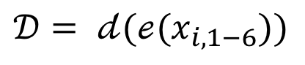
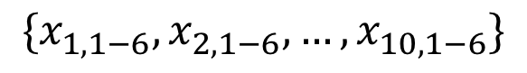
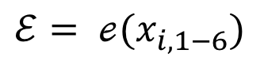
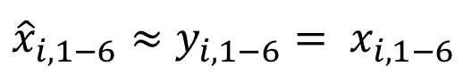
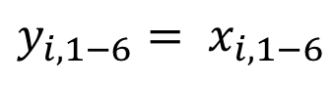
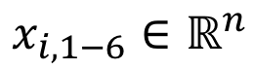
Background – Auto-encoder
$$\{x_{1,1−6}, x_{2,1−6},…, x_{10,1−6}\}$$
$$x_{i,1−6}∈ℝ^{n}$$
$$y_{i,1−6}= x_{i, 1−6}$$
Encoder:
$$ℰ= {ℯ(x}_{i, 1−6})$$
Decoder:
$$𝒟= {𝒹(ℯ(x}_{i, 1−6}))$$
$${\hat{x}}_{i,1−6}≈y_{i,1−6}= x_{i, 1−6}$$
Notes:
The Auto-encoder tries to learn a function ___, or an approximation to the identity function so that ___. The identity function is a s trivial solution, but by placing constraints on the network, on can extract interesting structures in the dataset. For instance, by restricting the number of features to be less than the original, the network is compelled to learn a compressed representation of the input.
If the input were completely random, then this compression task would be very difficult. But if some structure or non-linear relationship exists between features in the data, the algorithm will be able to discover some of the relationships.
A sparse auto-encoder is an unsupervised learning algorithm. It’s a simple way to automatically learn features from an unlabeled dataset that can be useful to process larger datasets. In this algorithm, the target values are equal to the input values.
Suppose you purchased a robot and you want to teach him to classify the Chinese characters by looking at the following example. The first 5 characters belong to the first category, the last 5 are the second category. And these 10 characters are the only training data you have. Now, unfortunately, the robot is too smart for the task. It has large enough memory to remember 5 characters. After seeing all the 10 characters, the robot learned a way to categorize them: It remembers all the first 5 characters exactly. As long as a character is not one of those 5, the robot will put the character into the second category. This character should belong to the first category. But because it never appeared in the training data, the robot hasn’t seen it before. Based on its algorithm, the robot will put this character into the second category, which is wrong. The robot failed the task because it’s too smart and the training data is too small.
This is the problem of over-fitting. But what is regularization and why can sparsity avoid over-fitting?
A little upset at your robot, you turn it off and go to put it back on its shelf. But you dropped your robot. You pick it up and shake it a little and hear a rattling noise inside…oops I it’s probably broken a little inside! So to test it, you decide to give it the same learning task again. You shook some of its memory chips off his head and essentially reduced its intelligence. Now, instead of being able to memorize 5 characters, the robot can only remember a character part. You let the robot do the training again by looking at all 10 characters and still force him to achieve the same accuracy. Because he can’t remember all 5 characters this time, you essentially force him to look for a simpler pattern. Now he discovers the common part of all the category A characters!
So instead of simply memorizing stuff, it has to look for simpler patterns from the data. In the case of the robot, when he could remember 5 characters, his “brain” has a vector of size 5: [把, 打, 扒, 捕, 拉]. Now after regularization (banging), 4 slots of his memory became unusable. In summary, the sparsity constraint helps the model find simpler patterns in the data without being super dependent on the values of the nodes around it.

Slide 7
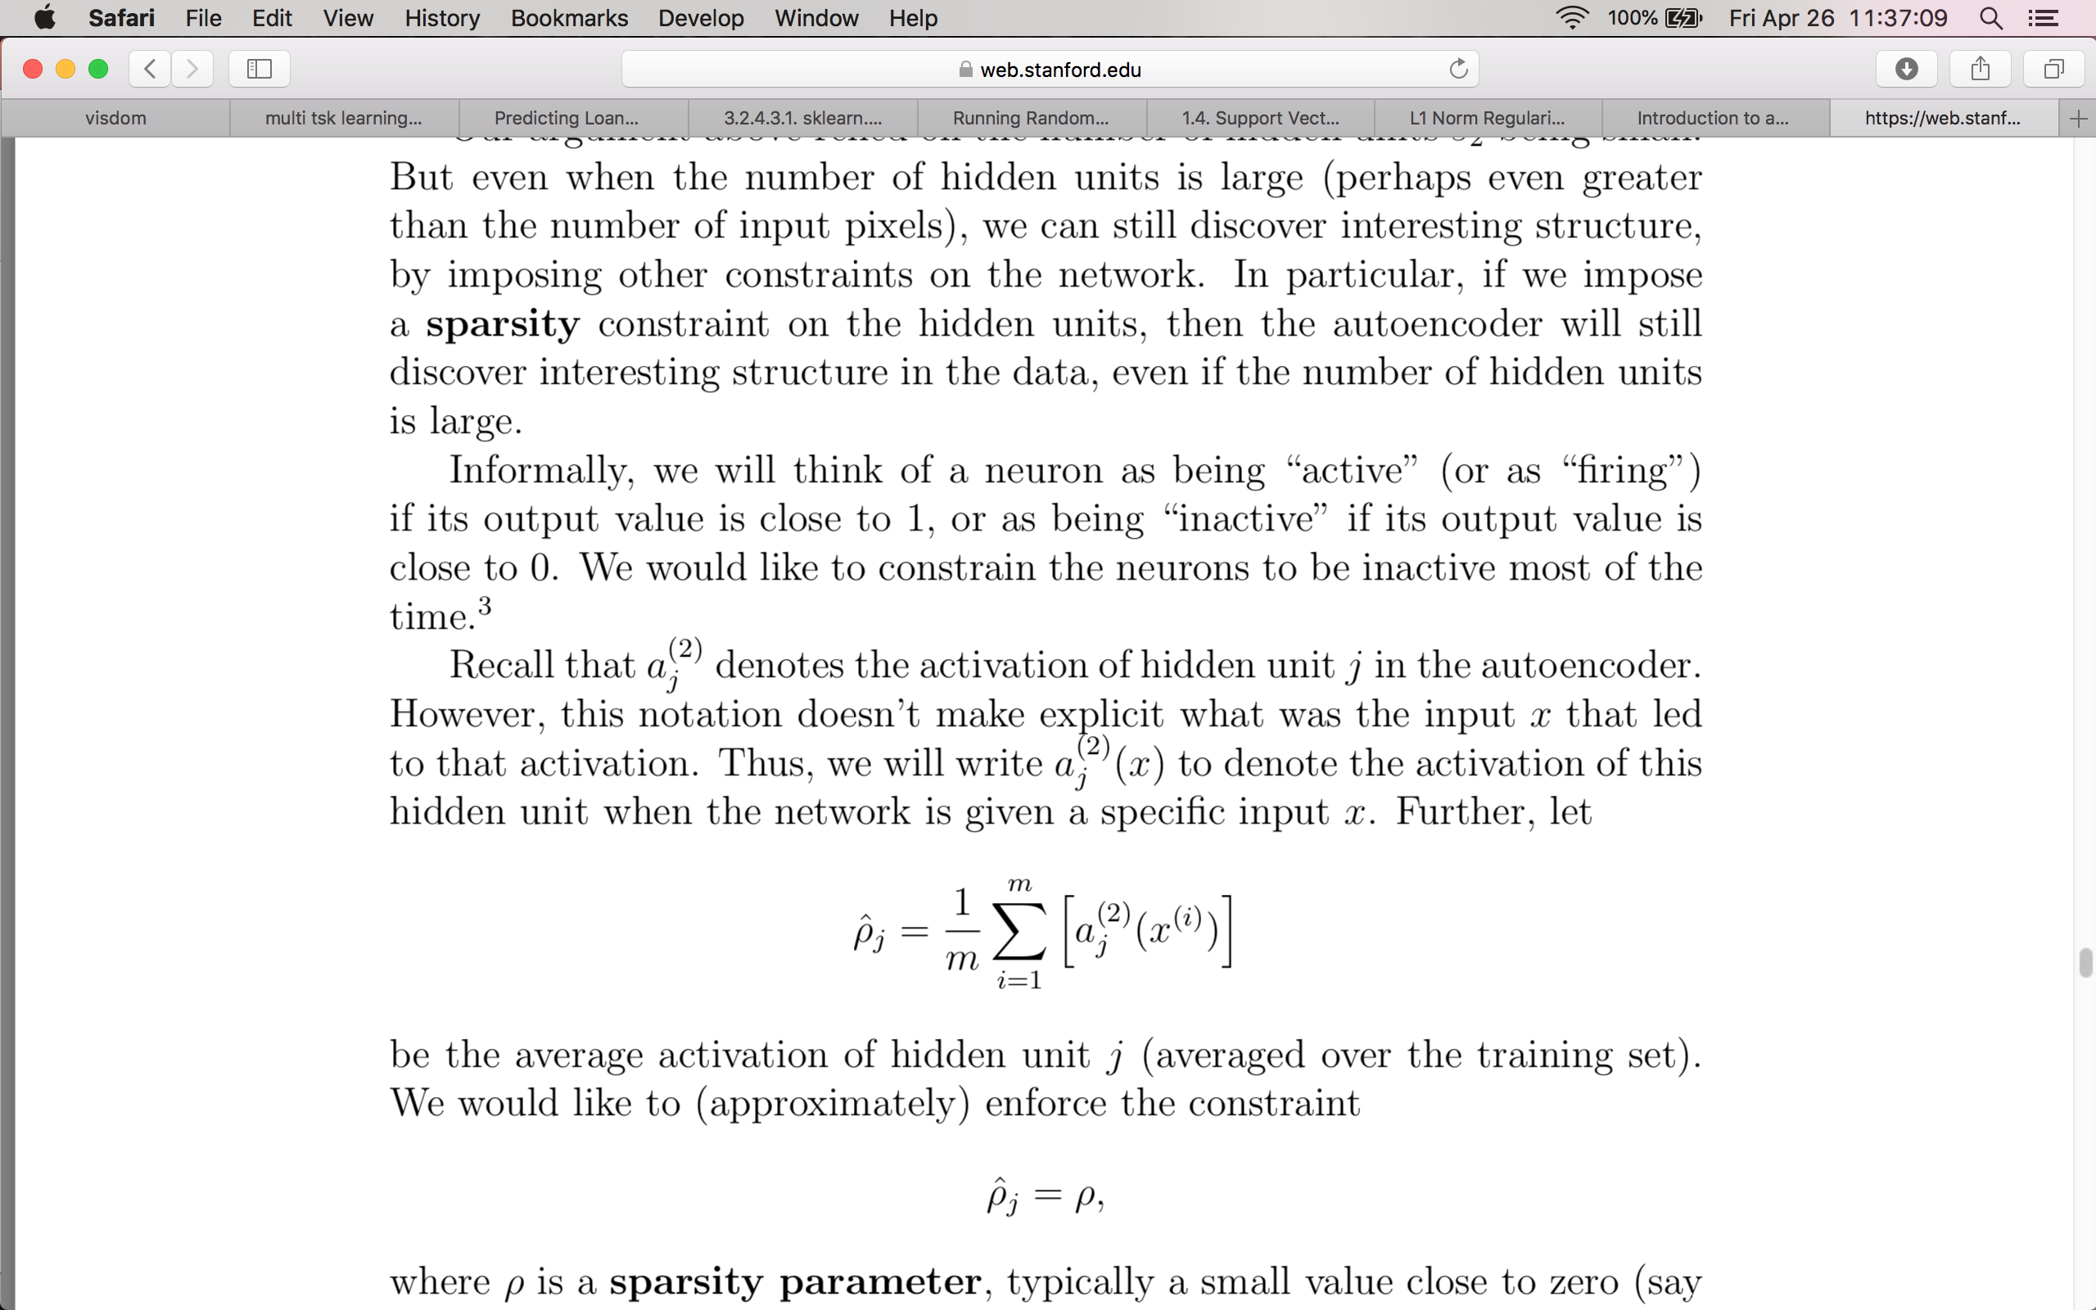
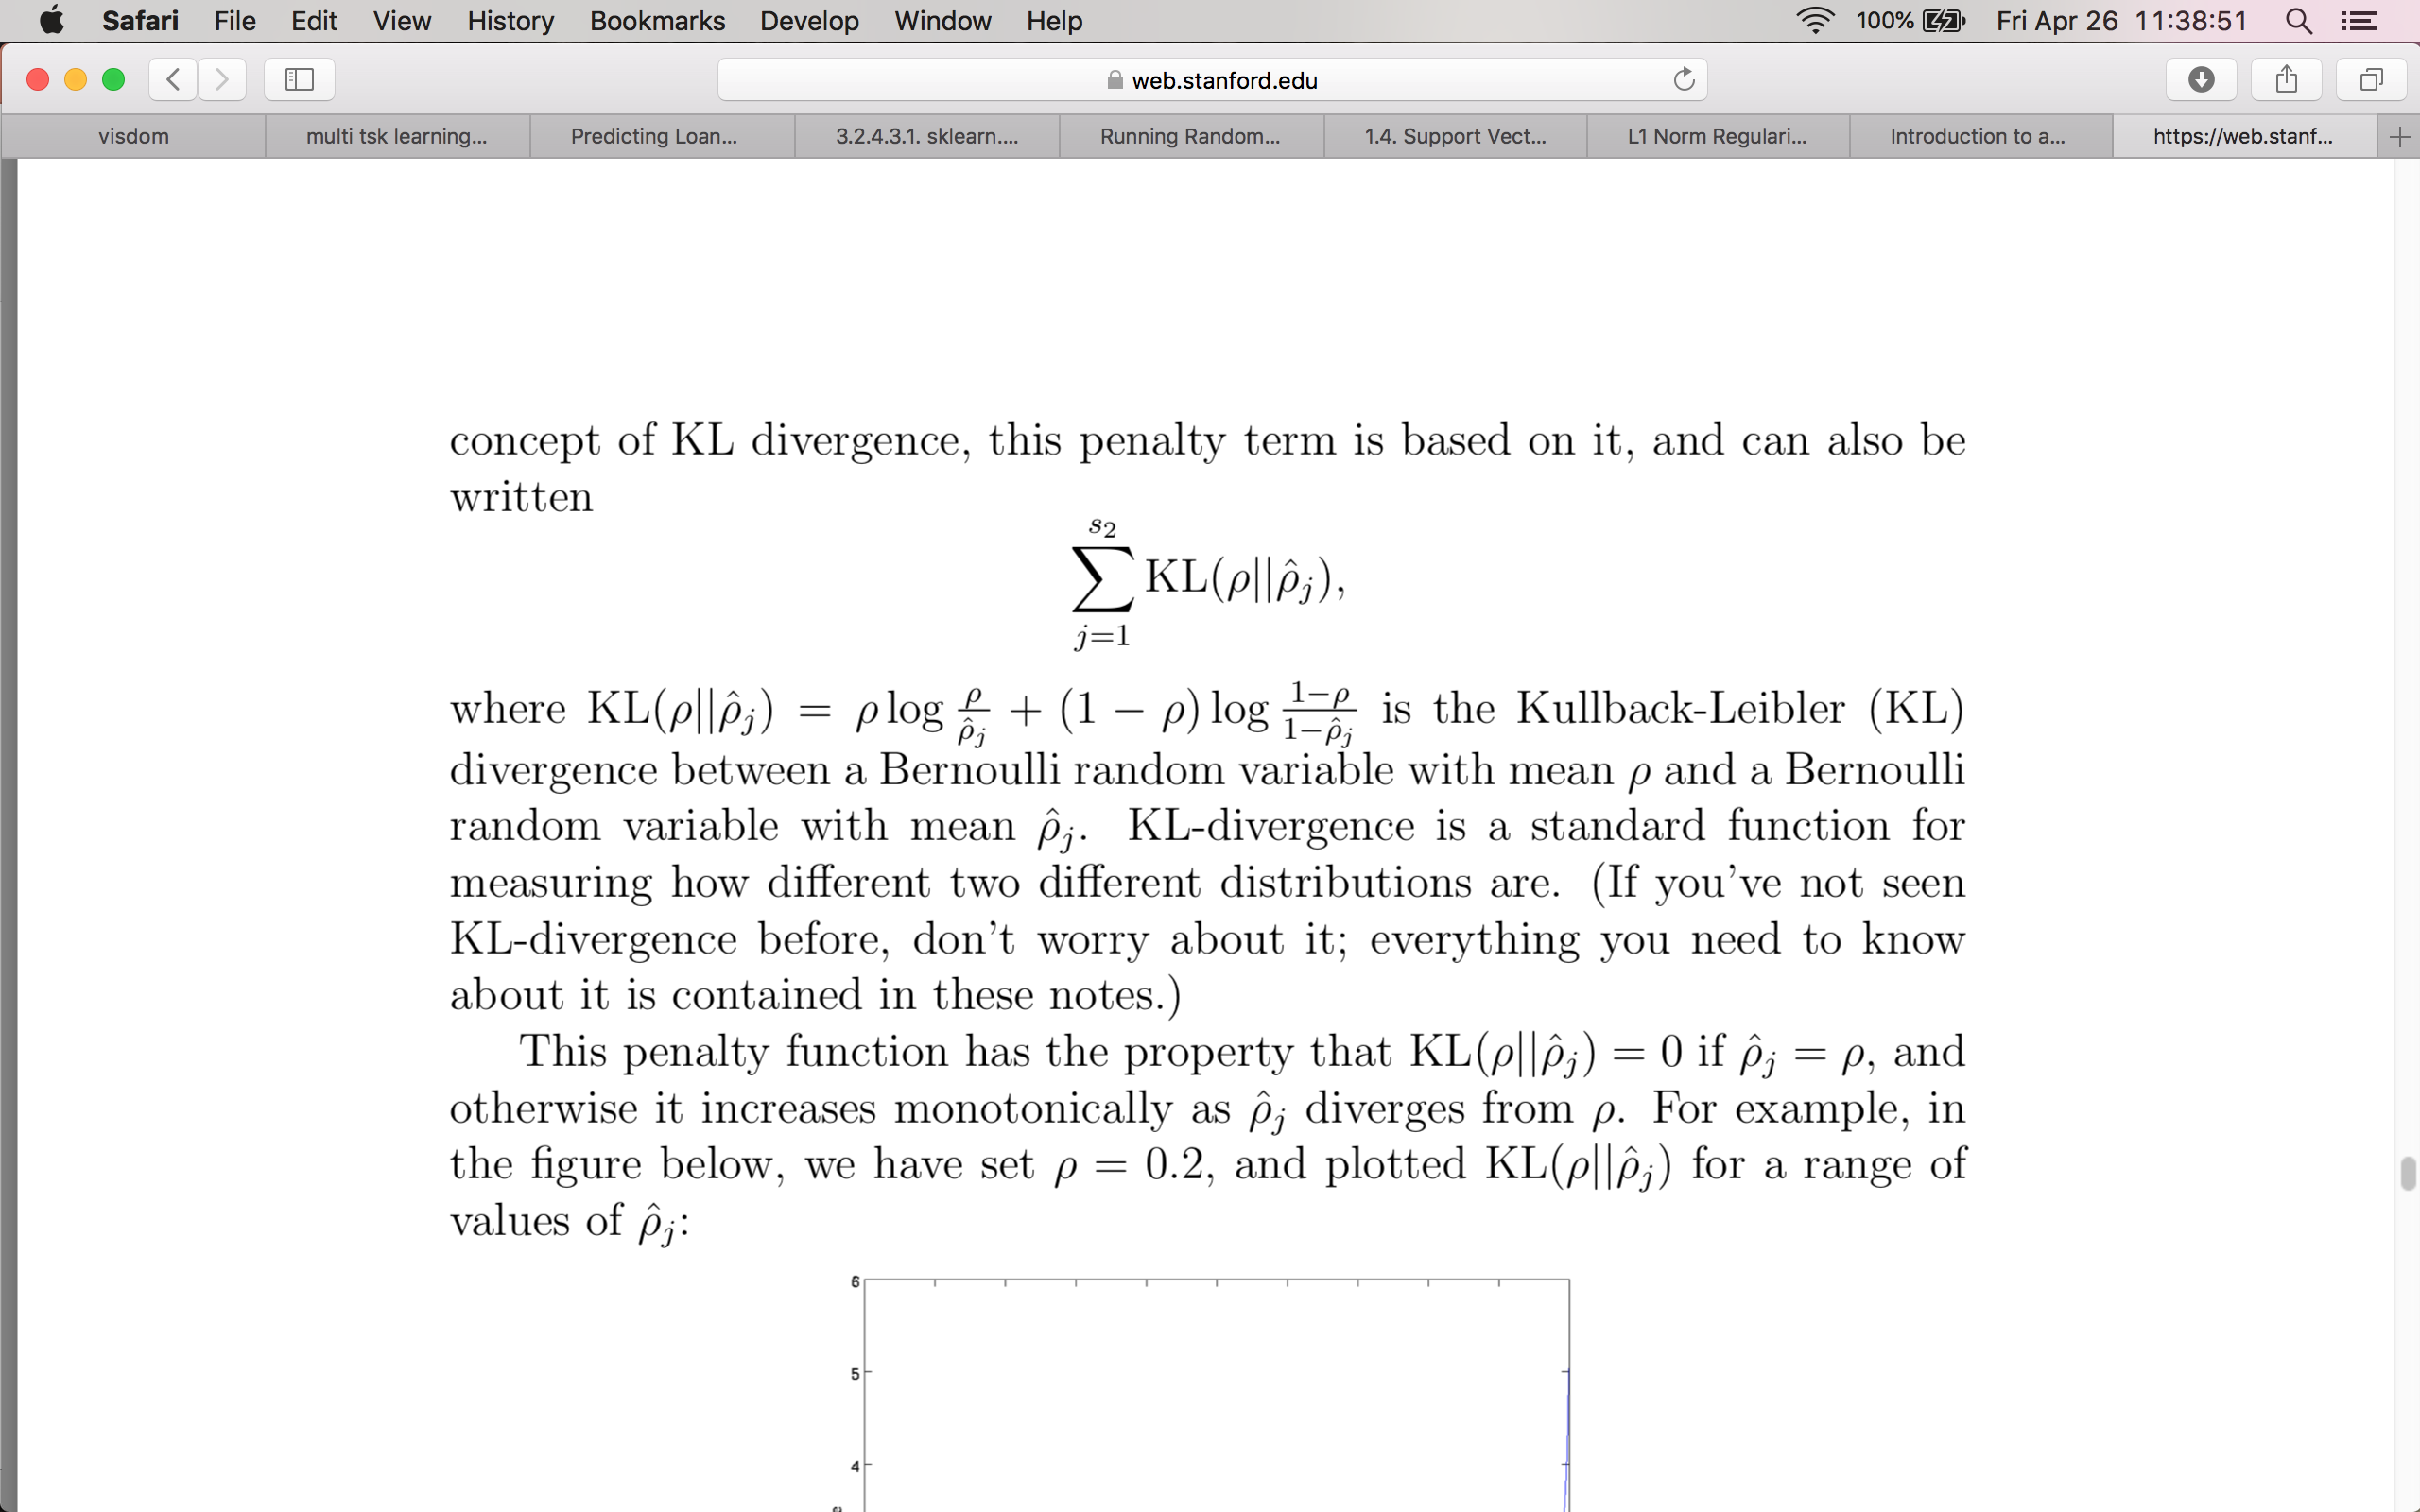
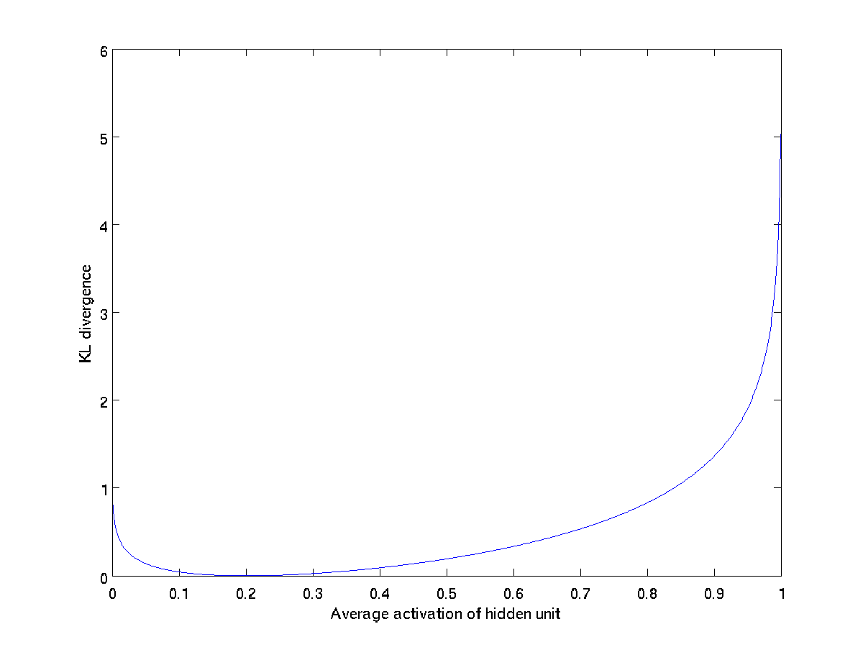
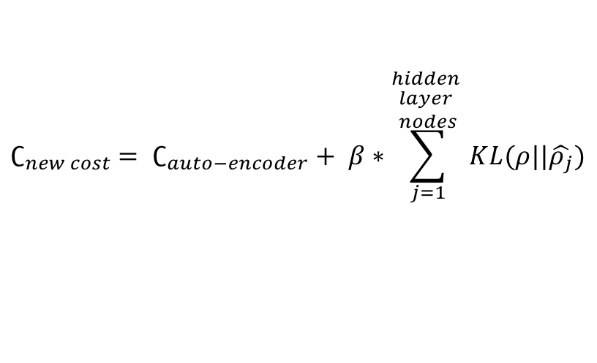
Background – Auto-encoder
$$∁_{new cost} = ∁_{auto−encoder}+ β∗\sum_{j=1}^{\begin{aligned}hidden \\ layer \\ nodes\end{aligned}}{KL(ρ||\hat{ρ_{j}})}$$
Notes:
To be a bit more mathematical:
In particular, sparse machine learning models are useful to make higher dimensional data easier to analyze. The results are easier to understand and generalizable to new tasks or new data.
Sparsity is a concept of interest in machine learning, statistics and signal processing.
It was first introduced in sparse coding in computational neuroscience for the visual cortex.
It is a key element in image recognition and deep convolutional models in variants of auto-encoders.
Some of the benefits of this model are:
Information disentanglement: a dense representation is highly entangled because any change in input modifies most entries in the representation vector. If a representation is sparse, a set of non zero features will be invariant to small changes in the input (possible noise) and hence robust.
Greater linear separability
Forcing too much sparsity, however, can hurt predictive performance because it reduces the overall effective capacity of the model
Informally, we think of a neuron as “active” if it’s output is close to 1 or inactive if its output is close to 0 (sigmoid activation function).
We would constrain it so that average activation of a hidden unit j (averaged over the training set). If __ and \rho is a small value, then the hidden unit’s activations must mostly be near zero.
We chose __ to be the penalty function .
If __ , otherwise it increases monotonically as __ diverges from \rho. Thus minimizing this term actually brings __.
KL-divergence is a standard function for measuring how different two different distributions are.
This penalty function has the property that KL(ρ||ρˆj) = 0 if ρˆj = ρ, and
otherwise it increases monotonically as ρˆj diverges from ρ. For example, in the figure below, we have set ρ = 0.2, and plotted KL(ρ||ρˆj) for a range of values of ρˆj
We see that the KL-divergence reaches its minimum of 0 at ρˆj = ρ, and blows up (it actually approaches ∞) as ρˆj approaches 0 or 1. Thus, minimizing this penalty term has the effect of causing ρˆj to be close to ρ.

Slide 8
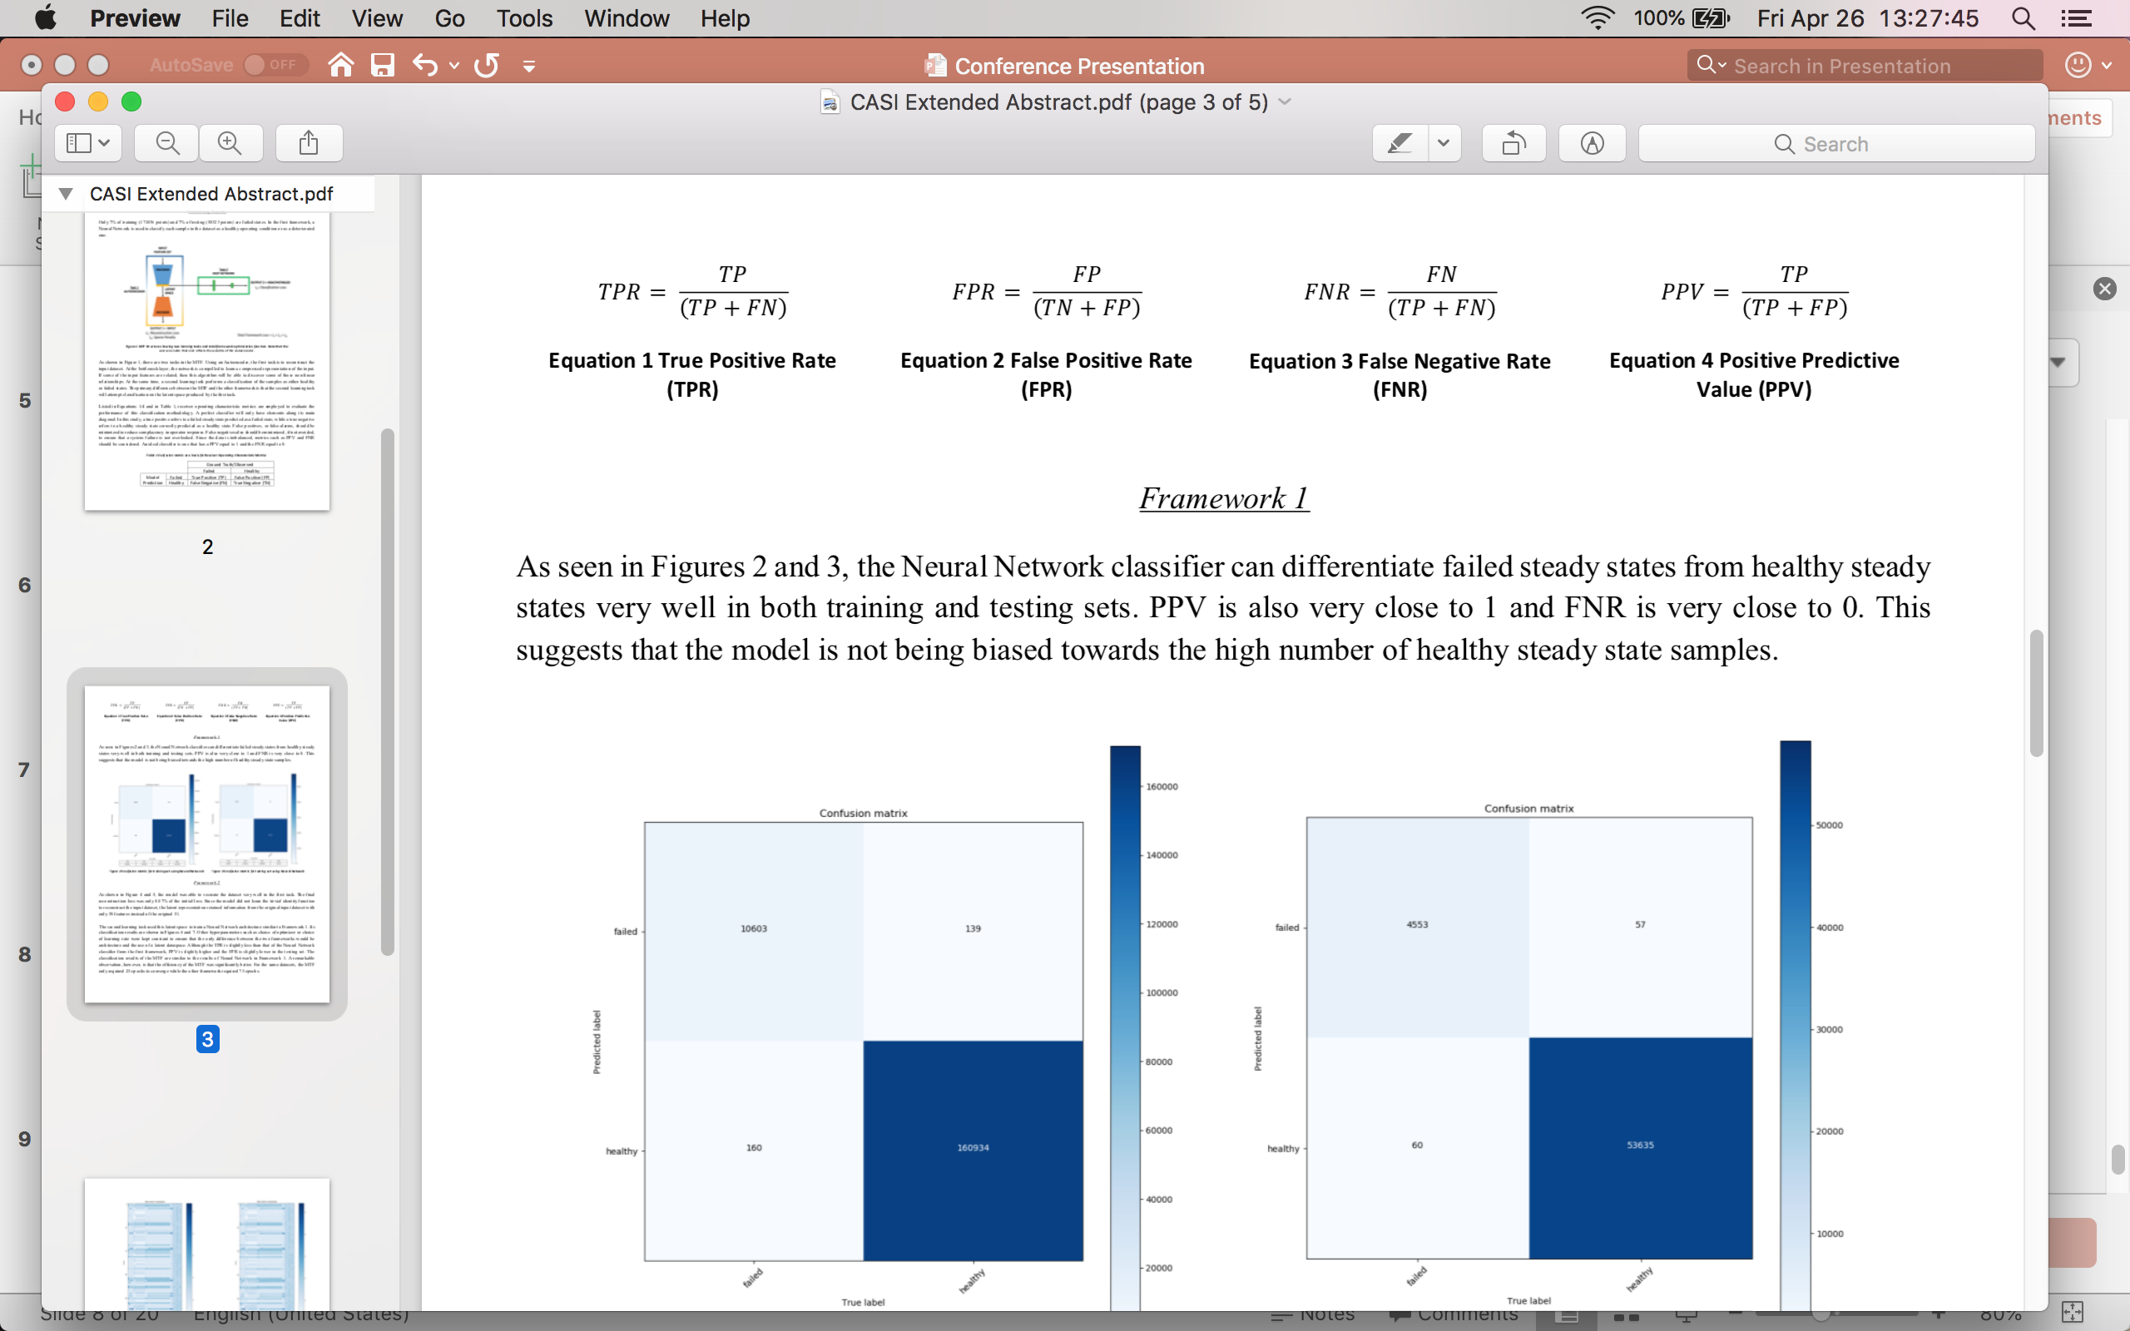
Background - ROC metrics
 |  | True Label
 |  | Failed | Healthy
Predicted Label | Failed | True Positive (TP) | False Positive (FP)
 | Healthy | False Negative (FN) | True Negative (TN)
Notes:
It is one of the most important evaluation metrics for checking any classification model’s performance.
A confusion matrix is a table that is often used to describe the performance of a classification model (or "classifier") on a set of test data for which the true values are known. The confusion matrix itself is relatively simple to understand, but the related terminology can be confusing.
Let's now define the most basic terms, which are whole numbers (not rates):
Show table**
true positives (TP): These are cases in which we predicted a failure, and the data point is a failure point.
true negatives (TN): We predicted a healthy point, and the datum is a healthy point.
false positives (FP): We predicted a failure condition, but it is in fact a healthy point (think of as a false alarm)
false negatives (FN): We predicted a healthy point, but it is actually a failure condition!
Using these basic values, the following metrics can be used.
True Positive Rate: When it's actually a failed point, how often does it predict a failure?
True Negative Rate: When it's actually a healthy point, how often does it predict a healthy system state?
Precision: When it predicts a failure, how often is it correct?
False Negative Rate: When the data points are failed system states, how often is it miss classified as healthy?
As you can tell by the formulas of these rates, if TN is really high (as in our case where we have a large number of healthy points), then the FPR is probably much smaller. Precision is not affected by a large number of negative samples because it measure s the number of TP out of the samples predicted as positive (show confusion matric overlapping). Similarly, FNR also does not deal with TN values. These two metrics are very useful for our purposes in evaluating performance.
ROC is a probability curve and AUC represents degree or measure of separability. It tells how much model is capable of distinguishing between classes. Higher the AUC, better the model is at predicting 0s as 0s and 1s as 1s. Or in our case properly distinguishing failure events in a dataset. However, this is most useful as an evaluation scheme when both classes have equal weight. The FPR rate will probably always be small, leaving us the TPR rate to make a good decision. But just because TPR rate is high, doesn’t mean it’s a good classifier! This is where Precision and FNR come in handy.

Slide 9
Multi-task learning
INPUT
Shared Layer
Task A
Task B
OUTPUT - A
OUTPUT - B
Notes:
Typically, we train single model for some task. We then fine-tune and tweak these models until their performance no longer increases. While we can generally achieve acceptable performance this way, by being laser-focused on our single task, we ignore information that might help us do even better on the metric we care about. Specifically, this information comes from the training signals of related tasks. By sharing representations between related tasks, we can enable our model to generalize better on our original task. This approach is called Multi-Task Learning (MTL) and will be the topic of this blog post.
MTL improves generalization by leveraging the domain-specific information contained in the training signals of related tasks - Rich Caruana
We can motivate multi-task learning in different ways: Biologically, we can see multi-task learning as being inspired by human learning. For learning new tasks, we often apply the knowledge we have acquired by learning related tasks
With hard-parameter sharing, It is generally applied by sharing the hidden layers between all tasks, while keeping several task-specific output layers. Hard parameter sharing greatly reduces the risk of overfitting. This makes sense intuitively: The more tasks we are learning simultaneously, the more our model has to find a representation that captures all of the tasks and the less is our chance of overfitting on our original task.
If a task is very noisy or data is limited and high-dimensional, it can be difficult for a model to differentiate between relevant and irrelevant features. MTL can help the model focus its attention on those features that actually matter as other tasks will provide additional evidence for the relevance or irrelevance of those features. Attention focusing
As different tasks have different noise patterns, a model that learns two tasks simultaneously is able to learn a more general representation. Learning just task Abears the risk of overfitting to task A, while learning Aand B jointly enables the model to obtain a better representation F through averaging the noise patterns. Implicit data augmentation
Finally, MTL acts as a regularizer by introducing an inductive bias. As such, it reduces the risk of overfitting as well as the Rademacher complexity of the model, i.e. its ability to fit random noise. Representation bias: when you train your model over an intersection of several tasks you push your learning algorithm to find a solution on a smaller area of representations on the intersection rather on a large area of a single task. It leads to faster and better convergence. Regularization
Feature selection double check: if one feature is important for more than just one task, then most probably this feature is indeed very important and representative for your data
All of the previous approaches thus assume that the tasks used in multi-task learning are closely related. However, each task might not be closely related to all of the available tasks. In those cases, sharing information with an unrelated task might actually hurt performance, a phenomenon known as negative transfer.
However, we still do not have a good notion of when two tasks should be considered similar or related. Caruana (1998) defines two tasks to be similar if they use the same features to make a decision. Baxter (2000) argues only theoretically that related tasks share a common optimal hypothesis class, i.e. have the same inductive bias. ^{[54]}propose that two tasks are F-related if the data for both tasks can be generated from a fixed probability distribution using a set of transformations F. While this allows to reason over tasks where different sensors collect data for the same classification problem, e.g. object recognition with data from cameras with different angles and lighting conditions, it is not applicable to tasks that do not deal with the same problem. Xue et al. (2007) finally argue that two tasks are similar if their classification boundaries, i.e. parameter vectors are close.
The term “multitasking” itself usually means something negative — a person who tries to do a lot of things and doesn’t succeed in anything of that is the best example. But here I want to talk about a bit different “multitasking”.
If I think about my vision system like that, what it outputs when I look at something? I can not just identify objects, segment them and understand the scene. I can also estimate the moods of people on the street, how they’re dressed, the weather based on their dresses, I can estimate what country or even city it is and a lot of other significant details that make my understanding from the visual channel really very rich.
Multitask learning is normal for humans (but maybe not multitasking haha)
When I learn a new language, especially a related one, I use my knowledge of languages I already speak to make shortcuts. The process works the other way too - learning a new language can help you understand and speak your own better.
Our brains learn to do multiple different tasks at the same time - we have the same brain architecture whether we are translating English to German or English to French. If we were to use a Machine Learning algorithm to do both of these tasks, we might call that ‘multi-task’ learning.
Rich Curanana - Multitask Learning is an approach to inductive transfer that improves generalization by using the domain information contained in the training signals of related tasks as an inductive bias. It does this by learning tasks in parallel while using a shared representation; what is learned for each task can help other tasks be learned better.[

Slide 10
Outline
Motivation
Literature Review
Background
ROC Metrics
Auto-encoders
Machine Learning Models
Multi-task Learning
Experimental Setup – Models
Results
Discussion
Summary

Slide 11
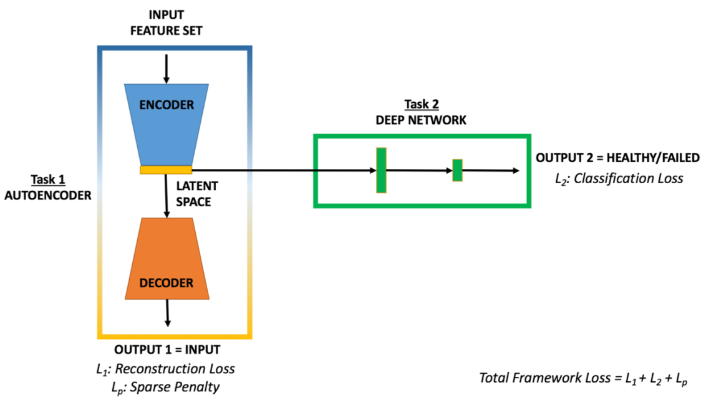
Experimental Setup - Models
Framework 1 – F1
In this work, we compare the new proposed machine learning model to an original framework.
We train an autoencoder with different layers to reduce dimensionality as well as extracting relevant features under constraints formulated by a cost function.
Mention parts to each type of framework
Mention the types of errors, learning rates, batch size etc
INPUT FEATURE SET
OUTPUT = HEALTHY/FAILED
L_{F1}= Classification Loss
Framework 2 - MTF

Slide 12
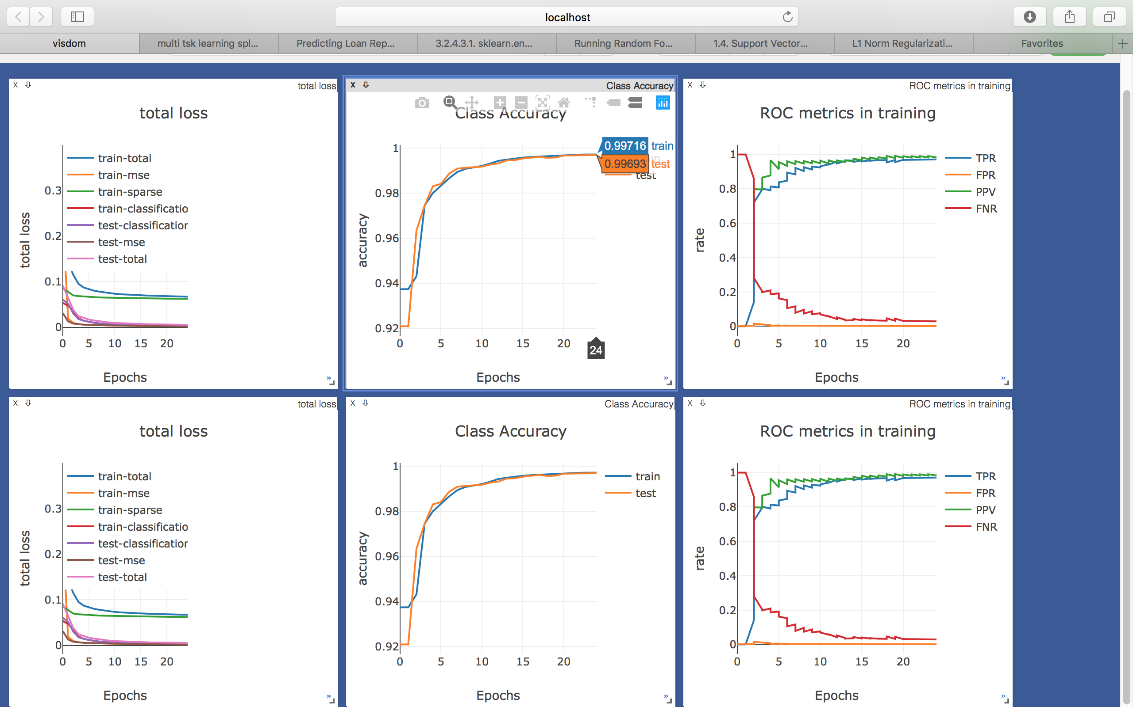
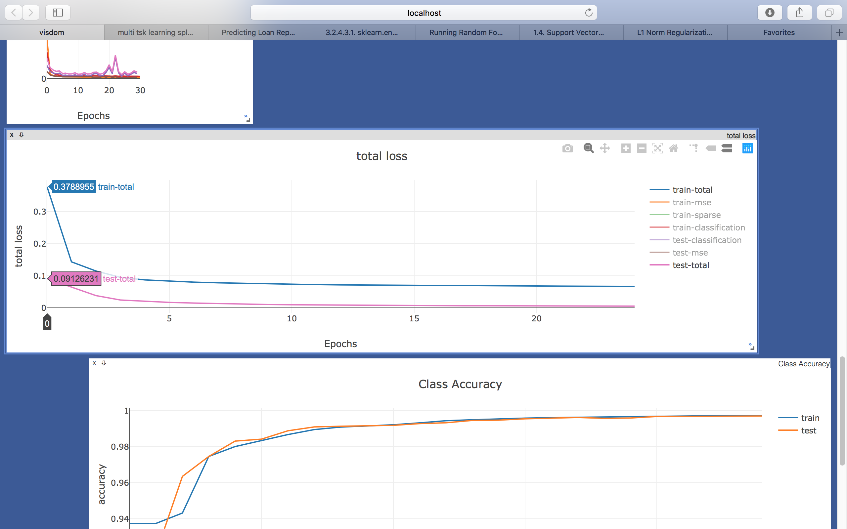
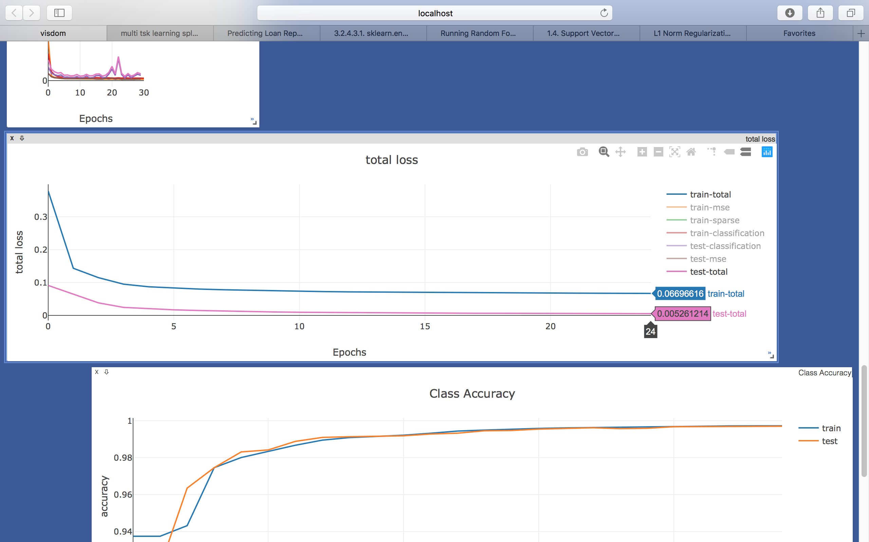
Results
Initial and Final Loss
Notes:
The outputs will be from reconstruction, classification and using SVM to show if linear separability has improved
Show the decrease in loss with an increase in accuracy and the ROC metrics curve for F2
Show the confusion matrices
The outputs will be from reconstruction, classification and using SVM to show if linear separability has improved
Show the decrease in loss with an increase in accuracy and the ROC metrics curve for F2
Show the confusion matrices

Slide 13
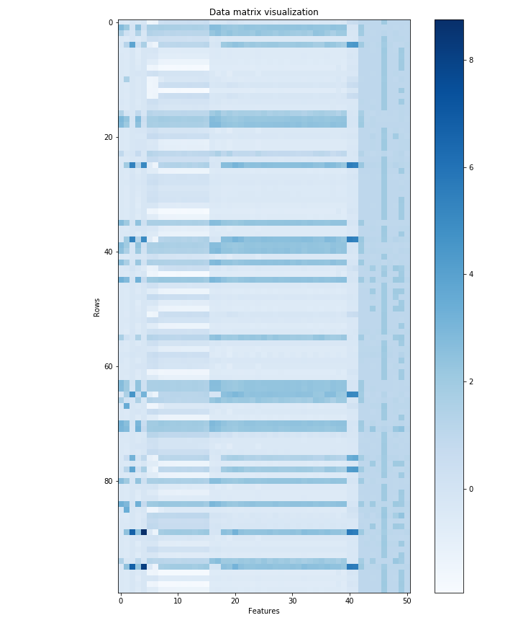

Notes:
Actual vs Model - AE

Slide 14
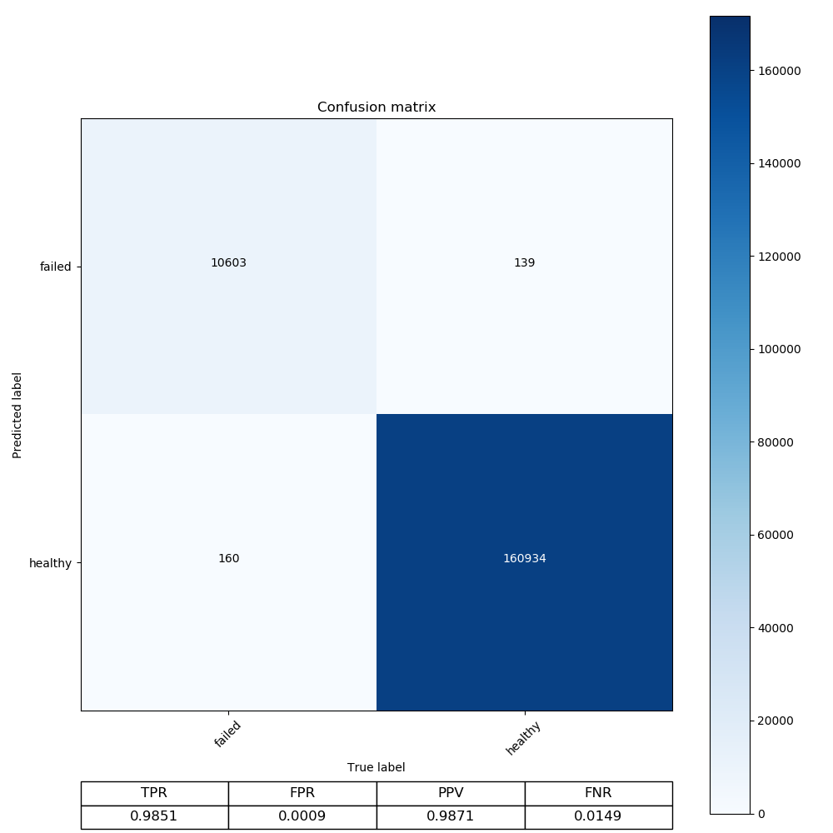

Notes:
Classification Results F1 vs MTF Training

Slide 15


Notes:
Classification Results – F1 vs MTF Testing

Slide 16
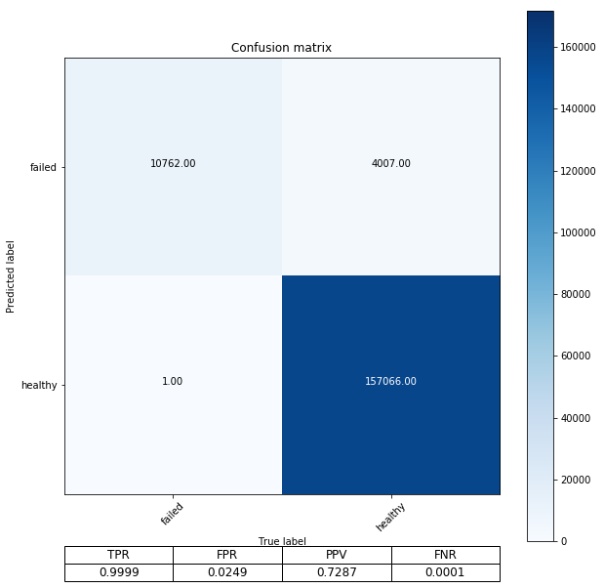
Notes:
SVM – F1 vs MTF Training
Linear separability!

Slide 17
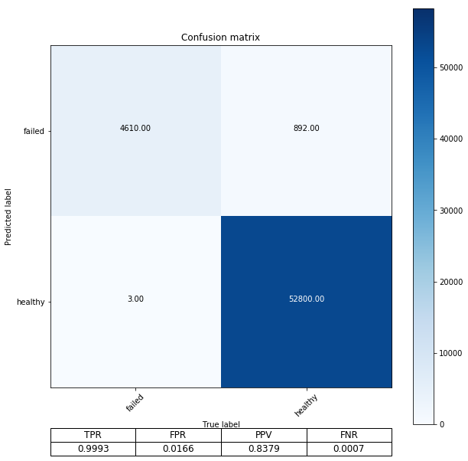
Notes:
SVM – F1 vs MTF testing

Slide 18
Discussion
SVM Accuracy (Linear Separability)
TRA |  |  |  | TST
TPR | FPR | PPV | FNR | TPR | FPR | PPV | FNR
1.0000 | 0.0475 | 0.5844 | 0.0000 | 0.9998 | 0.0482 | 0.6406 | 0.0002
0.9999 | 0.0249 | 0.7287 | 0.0001 | 0.9993 | 0.0249 | 0.8379 | 0.0007
 | Total Reconstruction Loss |  | Classification Accuracy
 | TRA | TST | TRA |  |  |  | TST
 |  |  | TPR | FPR | PPV | FNR | TPR | FPR | PPV | FNR
F1 | / | / | 0.9851 | 0.0009 | 0.9871 | 0.0149 | 0.9870 | 0.0011 | 0.9876 | 0.0130
MTF | 16.7% of initial loss | 7% of initial loss | 0.9712 | 0.0011 | 0.9833 | 0.0288 | 0.9705 | 0.0008 | 0.9905 | 0.0295
Notes:
Menion that the intrinisic dimension estimates to show why going from 51 dfeatures to 30 was still a choice that was theoretically within bounds
Discuss different network architectures to show how this one in particular did better than the rest
Different Network Architectures:
Batch size was explored
Learning rate was explored
Number of hidden layers and nodes in the layers in both networks were explored
Regularization factor to control the weighting of the sparse penalty was explored
The sparsity constraint was explored
The types of activation functions used in both networks were explored
Discuss the ROC metrics for performance evaluation
Talk about PR AUC as a vidual to demonstrate how one framework might be better than the other
SVM separability as a result of MTF
Mention finally that the time taken to process is 3 times less although the end accuracy is about the same eeven if SVM results are better. This warrants a deeper investigation

Slide 19
Summary and Future Steps

